Slide 1
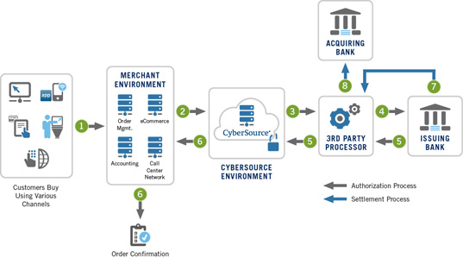

Slide 2
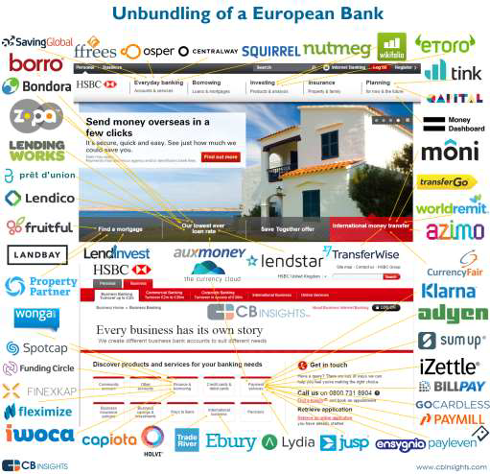
The Fintechtsunami
Copyright © 2016 Kantox

Slide 3
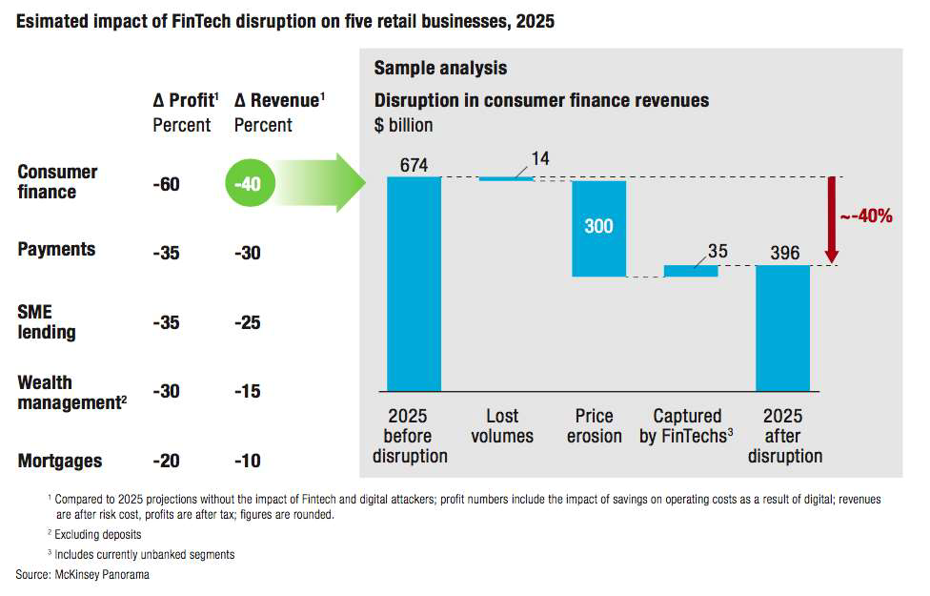
The Fintechtsunami
Fintechwould reduce banks revenues and profits by up
to 40% and 60% over the next decade
McKinsey
Copyright © 2016 Kantox

Slide 4
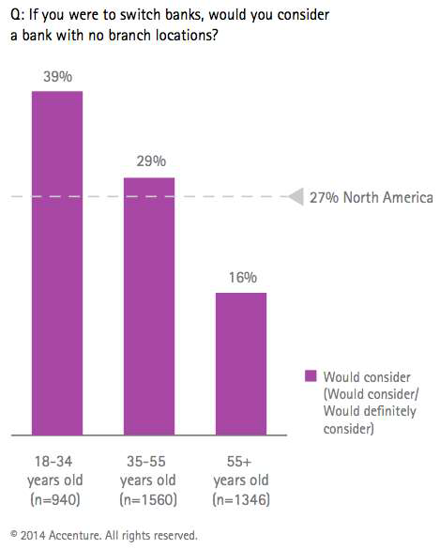
Fintechbanks
Branchless banking is gaining acceptance
Copyright © 2016 Kantox

Slide 5
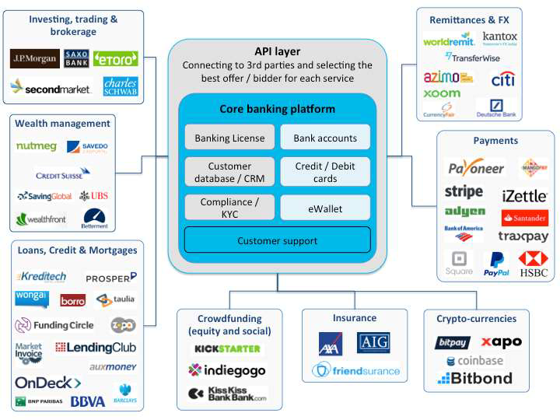
Fintechbanks
Marketplace banking: core banking platform + API layer
+ CRM + KYC + Banking License
Copyright © 2016 Kantox

Slide 6
Fintechbanks
Uberis now the largest acquirer of small business bank
accounts in the US today
•30% of Uberdrivers in the US have never had a bank account
•To be a driver on Uber, they need a minimum of a debit card to get
paid
•Uberhas had to solve this problem by allowing drivers to sign up for
a bank account as part of the Uberdriver application process, in
real-time
The next obvious move is to design day-to-day banking into Uber’sapp
(including financing cars, leasing, insurance…)
Copyright © 2016 Kantox

Slide 7
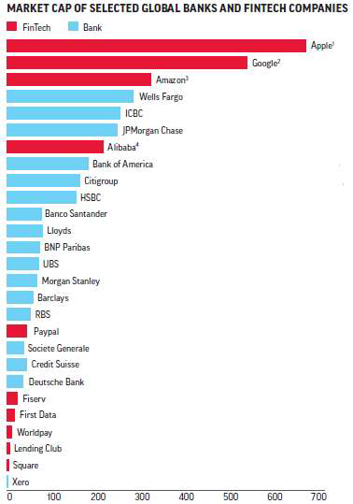
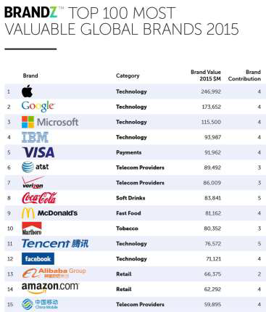
Fintechbanks
Banks are frightened by
GAFAs financial power
and brand image
Copyright © 2016 Kantox

Slide 8
